Slide 1
PRESENTATION ON CONTRACT MANAGEMENT
Issued by
Kenya National Highways Authority
12th November, 2024

Slide 2
VISION & MISSION OF KeNHA
VISION : A Quality National Trunk Network to All for Prosperity.
MISSION : To Develop and Manage Resilient, Safe and adequate National Trunk Roads for Sustainable Development Through Innovation and Optimal Utilization of Resources.

Slide 3
MANDATE OF THE AUTHORITY
KeNHA’s MANDATE is Management, Development, Rehabilitation and Maintenance of National Trunk Roads”.
The national roads are classified as S,A & B. These are sometimes referred to as national trunk roads.

Slide 4
MAINTENANCE & CORRIDOR MANAGEMENT
Maintenance Department is one of the departments charged with responsibilities to enable the Authority achieve its mandate.
The primary responsibility is to ensure that all roads (except those under construction contracts) are maintained to the best possible standards using available resources.

Slide 5
MTCE & CORRIDOR MANAGEMENT
The Authority has 10 Regional Offices and 4 Corridors namely; A, B, C & D to handle the maintenance activities as per the workplans (available budget & timing) developed annually.
Regular maintenance activities are usually described as either Routine or Periodic or Performance Based Contracting (PBC).
However, others like Spot Improvements or Emergencies may also be done as the need arises.

Slide 6
MTCE & CORRIDOR MANAGEMENT
planning- road condition, budget [engineer]
Procurement [procurement]
Execution [engineer]
Closure [both procurement engineer]

Slide 7
ROADWORKS CONTRACTORS
The maintenance works are carried out through the services of Roadworks Contractors.
The Contractors (or their Agents/Supervisors) must therefore understand the works specifications and performance requirements as laid down in the contract document signed by both parties. In this regard, Contractors must engage technically competent staff to manage the works on their behalf.

Slide 8
CONTRACT MANAGEMENT
Roadworks are managed by observing the conditions and specifications as detailed in the contract document. These are:-
Conditions of Contract (Parts I and II) - FIDIC 1999
-Part I – General Conditions of Contract(FIDIC)
General for Civil Engineering works.
Published by the Federation Internationale Des Ingenieurs – Conseils (FIDIC). Copies are obtainable from FIDIC Secretariat in Lausanne, Switzerland.
-Part II – Particular Application
Supplement the General Conditions Contract and prevail in case
of conflict in any clause.

Slide 9
CONTRACT MANAGEMENT
Specifications of Contract
These are the Technical requirements.
-Standard Specifications
Standard technical & quality requirements for the works.
Standard Specifications for Road and Bridge Construction, 1986
Edition published by the Ministry of Transport & Communications is in use. Copies are obtainable from the Ministry of Roads.
-Special Specifications
Specific to the works being done.
Supplement, revise or amend the Standard Specifications.
Prevail in case of conflict.

Slide 10
CONTRACT MANAGEMENT
Priority Order of Contract Documents
The Contract Agreement (completed, signed & stamped)
The Letters of Acceptance
The Form of Tender and Appendix to form of tender
Conditions of Contract Part II (Particular Applications)
Conditions of Contract Part I (General - FIDIC)
Special Specifications
Standard Specificationsfor Road and Bridge Construction, 1986
Road Maintenance Manual, May 2010 Edition and Performance Based Contract Manuals
Drawings
Bills of Quantities (priced)

Slide 11
CONTRACT MANAGEMENT
Issues to Observe
1. Right of Access and possession of site
After the Contract Agreement is completed, signed & stamped by both parties, the Employer will grant you Right of Access and Possession of site [Clause 2.1]
The Engineer (in our case is the Direct–Maintenance) will issue Notice of commencement [Clause 8.1]
2. Requirement
      Well resourced Programme of Works covering the contract period [Clause 8.3]

Slide 12
CONTRACT MANAGEMENT
Issues to Observe
1. Time for Completion of Works (Clause 8.3 of CoC)
This is specified in the Appendix to Tender.
Delays in completion of works attract penalty charges known as liquidated damages for each day the works remain uncompleted.
Works are considered complete once a certificate of substantial completion (aka taking-over certificate) is issued by the Engineer.
Half of retention money (if applicable) is released to Contractor upon issuance of this certificate, while the last half is released after the defects notification period has expired and the Contractor has completed any works that may have been outstanding, and remedied all defects that may have arisen from their workmanship. End of Defects Notification Period certificate (aka Final/Handing over certificate) must be issued by the Engineer
The time for completion may be extended in accordance with Clause 8.3 of the Condition of Contract(CoC).

Slide 13
CONTRACT MANAGEMENT
Issues to Observe
2. Rate of Progress (Clause 8.6 of CoC)
The rate of progress should conform to the Contractor’s programme of works (Clause 8.3).
Persistent failure by the Contractor to comply with the programme and time for completion may also lead to default (Clause 2.5) considerations, hence termination (Clause 15.2) of contract.

Slide 14
CONTRACT MANAGEMENT
Issues to Observe
3. Site Instructions
These are issued in writing by the Resident Engineer, who has the delegated authority from the Engineer. Instructions may be issued verbally on site, but must be subsequently confirmed in writing.
Site instructions form the contractual basis for reimbursement or compensation for works undertaken as per the BoQs and specifications.

Slide 15
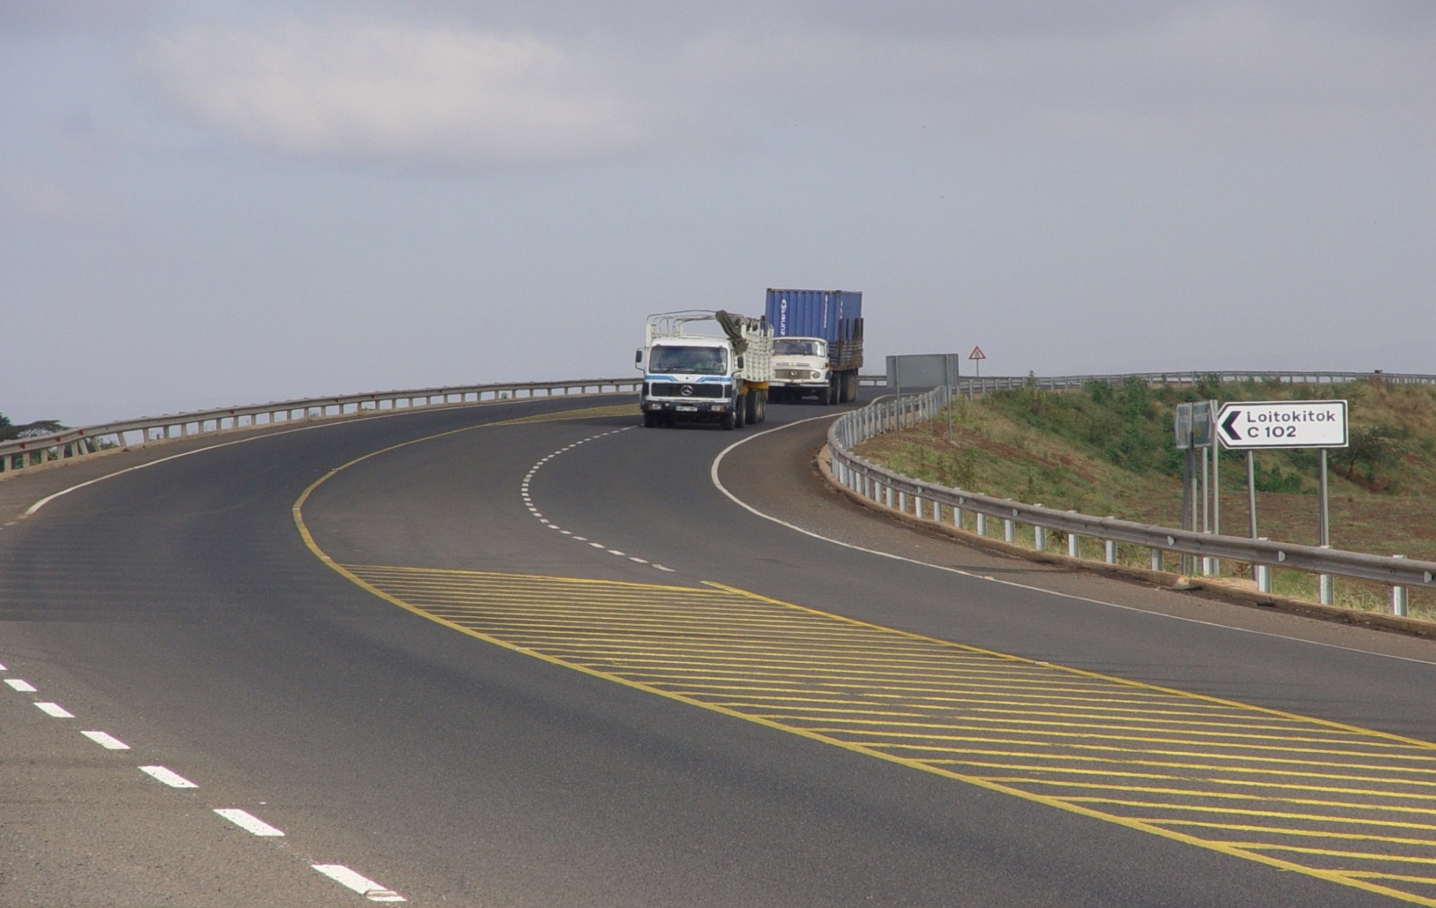
Thank you

